Slide 1
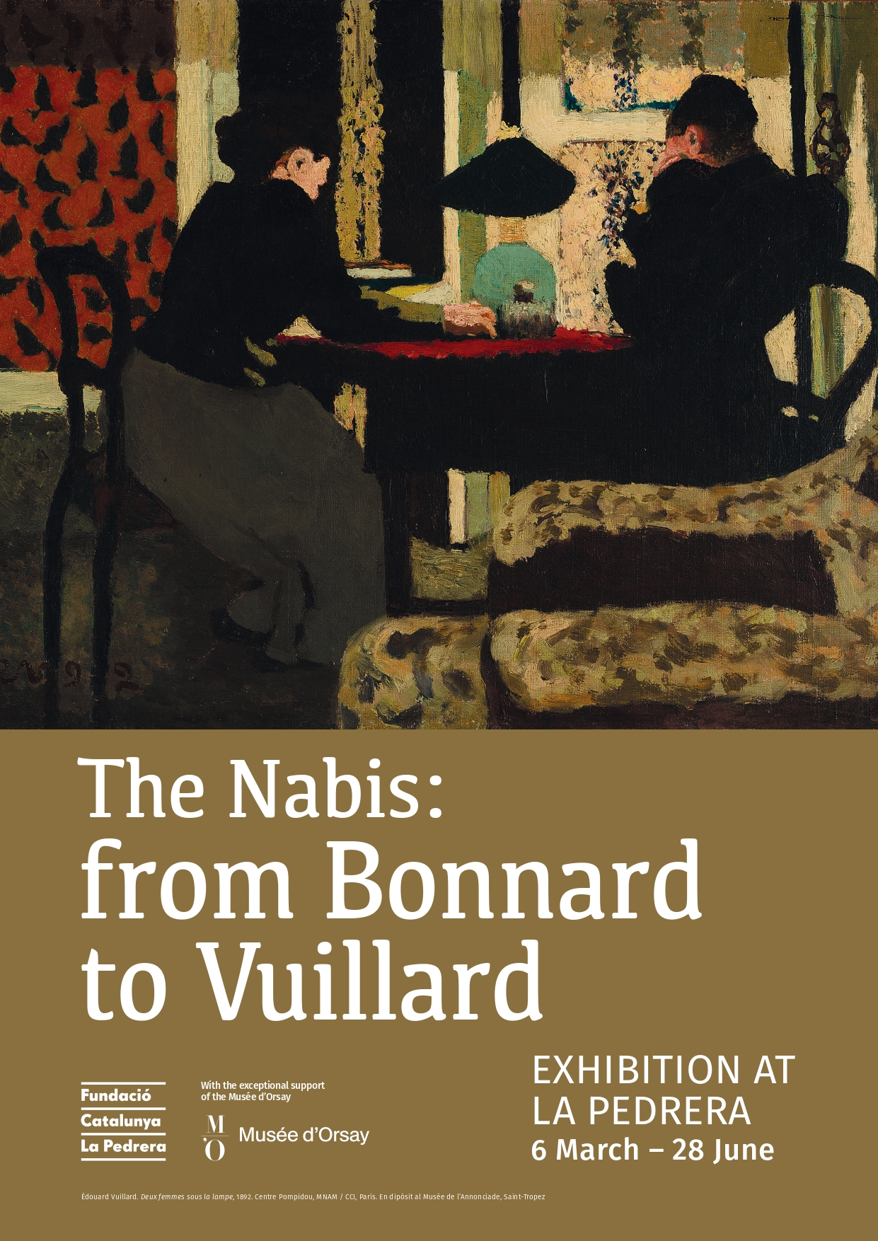
La Pedrera
From 9 October 2025 to 25 January 2026
Press kit

Slide 2
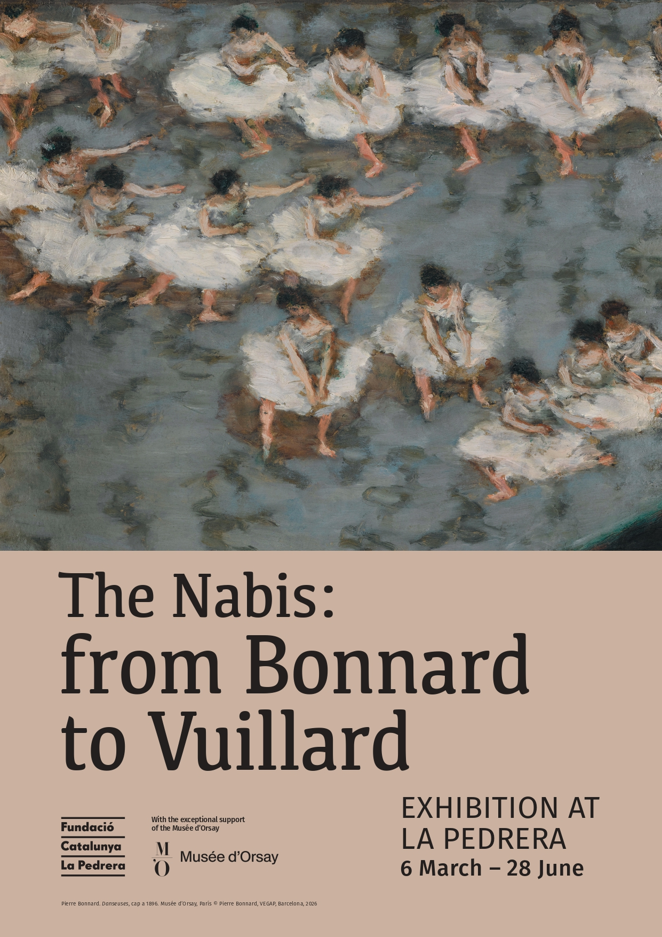
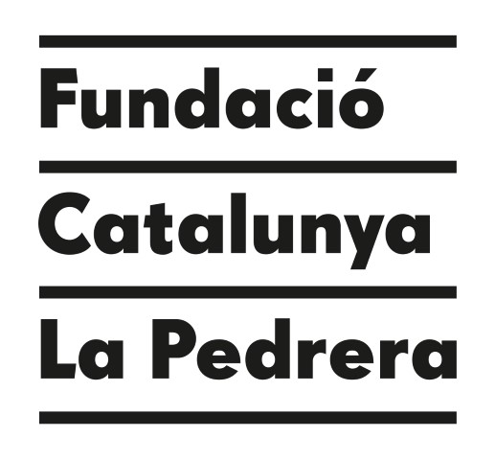
“I consider myself more a builder than a sculptor or an architect, in the sense that the purpose of my art is to create places that are truly moving.”

Slide 3
The Fundació Catalunya La Pedrera presents “The Nabis: from Bonnard to Vuillard”, an exhibition on the intimate revolution of modern art.
It is the first exhibition in Barcelona to focus exclusively on this movement.
“The Nabis: from Bonnard to Vuillard” explores how a group of artists transformed painting in the late 19th century, putting feelings, subjectivity and daily life front and centre in their pieces.
Organised with exceptional support from the Musée d’Orsay, the display presents the aesthetic principles, influences and key concepts that define Nabi art. Through a broad selection of works, it reveals the beauty, diversity and creativity of this movement, which played a key role in the transition from Impressionism to the early avant-garde movements of the 20th century.
The exhibition looks more closely at two key figures: Pierre Bonnard, with his exploration of light and colour, and Édouard Vuillard, whose work is marked by introspection and the psychological aspect of domestic space.
There is no better place for an exhibition on the Nabis than Casa Milà. One of the main focal points of this exhibition is the Nabis’ desire to break down the barriers between art and life.
The members of this group didn’t believe in a hierarchy of painting and decorative arts: all art should be part of the day-to-day experience. This approach has a natural connection to La Pedrera, which Antoni Gaudí designed as a complete work of art, melding architecture, shape and daily life.
The exhibition, featuring nearly two hundred works, is divided into thematic sections to present the group’s main characteristics and subject matters.
The display is a great opportunity to see an important selection of pieces from private collections and museums and institutions, including the Musée d’Orsay, Centre Pompidou, Petit Palais, Fondation Dina Vierny - Musée Maillol in Paris, Musée Bonnard in Le Cannet, Musée Départemental Maurice Denis in Saint-Germain-en-Laye, Thyssen-Bornemisza National Museum in Madrid, Fondation de l’Hermitage in Lausanne, and MAH - Musée d‘Art et d‘Histoire in Geneva, all in one place.

Slide 4
The Nabis
Paul Sérusier
Portrait de Paul Ranson en tenue nabique, 1890
The Nabis, a group whose name is derived from the Hebrew neviim meaning prophets, sought to contribute a new creative vision and generate a total art conceived in perfect harmony with modern life.
Active between 1888 and 1900, the group formed around Paul Sérusier (1864-1927), initially with students from the Académie Julian in Paris: Paul-Élie Ranson (1861-1909), Pierre Bonnard (1867-1947), Édouard Vuillard (1868-1940), Maurice Denis (1870-1943). They were soon joined by Henri-Gabriel Ibels (1867-1936), Georges Lacombe (1868-1916), Aristide Maillol (1861-1944), József Rippl-Rónai (1861-1927), Ker-Xavier Roussel (1867-1944), Félix Vallotton (1865-1925) and Jan Verkade (1868-1946).
Two main currents coexisted within this small community. The first, centred around Paul Sérusier, were more concerned with aesthetic principles and theory –such as Maurice Denis, Paul Ranson, Ker-Xavier Roussel, Jan Verkade and Charles Filiger. These artists were drawn to intellectual themes related to spirituality, poetry and esotericism. In this regard, they were part of an emerging scepticism towards science. Sérusier and Ranson were captivated by esotericism and theosophy, while Maurice Denis and Jan Verkade were rooted in Catholic spirituality. All were influenced by Symbolism.
The other Nabi current included Pierre Bonnard, Édouard Vuillard, Félix Vallotton and József Rippl-Rónai, who were interested in topics from contemporary life. Without literally depicting the frenzy of modern society, their art aimed to extract deeper values.
Despite the differences among group members, the Nabis were united by the idea of restoring a decorative quality to painting. Eager to reunify the arts, the group embraced a wide range of techniques –painting, drawing, printmaking, sculpture– and many of its members worked beyond the canvas, producing wallpaper designs, tapestries, folding screens and manufactured objects, as well as interior decoration. Their aim was to enhance everyday life with creations that reflected the reconciliation of artist and craftsman.

Slide 5
The movement built on Paul Gauguin’s aesthetic explorations in the late 1880s, after the last Impressionist exhibition in 1886.
Seduced by Gauguin’s Synthetism and Symbolist analysis, based more on suggestion than lifelike representations of reality, the Nabis took these principles as their own. Also influenced by Japanese art, they favoured saturated colours, refined shapes and a two-dimensional expression of space.
Although they explored some of the same topics, such as daily life, intimacy, leisure activities and spirituality, the Nabis never developed a uniform visual language. The group was made up of a wide variety of personalities. They were painters above all, but they aimed to do away with the separation between fine art and applied arts.
Encouraged by art dealer and publisher Ambroise Vollard, they experimented with a wide variety of techniques, particularly printmaking, in order to create affordable serial pieces.
They firmly believed art should enhance everyday life and be accessible to everybody, making this ideal the driving force for their collective commitment. Favouring innovation, they cultivated their mission as prophets of a new art movement.
Maurice Denis
Portrait de Madame Ranson au chat, 1892

Slide 6
The Nabis at La Pedrera
The exhibition Fundació Catalunya La Pedrera is putting on at La Pedrera —the first monographic show dedicated entirely to this movement to be held in Barcelona— features a selection of more than 200 pieces created by artists working in France between 1888 and 1900. It has been made possible thanks to exceptional support from the Musée d’Orsay.
There is no better place for an exhibition on the Nabis than Casa Milà, also known as La Pedrera: an iconic Modernisme building in Barcelona designed by Antoni Gaudí (1852–1926) between 1906 and 1912, where functional ornamental design and architecture come together in harmony.
This display presents the aesthetic principles, influences and key concepts that define Nabi art. Through a broad selection of works, it reveals the beauty, diversity and creativity of this movement, which played a key role in the transition from Impressionism to the early avant-garde movements of the 20th century.
Paul Sérusier
Le talisman. Paysage au bois d’Amour, 1888
“The exhibition features paintings, but also drawings, prints and sculptures. The Nabis worked beyond the canvas, producing wallpaper designs, tapestries, folding screens and manufactured objects, as well as interior decoration.”

Slide 7
“Remember that a painting —before being a battle horse, a nude woman or an anecdote of some sort— is essentially a flat surface covered with colours, put together in a certain order.”
Maurice Denis
The exhibition is broken down into nine thematic sections, corresponding to the main focal points of the Nabis’ work. These clearly show the characteristics that united the group while also highlighting the elements that set them apart:
• The Nabi brotherhood
• An aesthetic revolution
• Parisian life
• Theatre, music and shows
• Symbolism. Between esotericism, dreams and mysticism
• Landscapes and gardens
• Modern decoration
• Representations of daily life
• The Mediterranean
Pierre Bonnard
La place de Clichy, 1898

Slide 8
A walk through the exhibition
The Nabi brotherhood
The Nabis were more a loose brotherhood of artists than an official group. Initially, the core group comprised Paul Sérusier, Paul-Élie Ranson, Pierre Bonnard, Édouard Vuillard and Maurice Denis, all from Académie Julian. Other artists joined later: Henri-Gabriel Ibels, Georges Lacombe, Aristide Maillol, József Rippl-Rónai, Ker-Xavier Roussel, Félix Vallotton and Jan Verkade.
In the beginning, the group was almost like a semi-secret society. Each member had a nickname and they all made an intellectual and aesthetic pact based on their shared love of mystery, theosophy, esotericism, and religious and secular texts related to Symbolism.
The group met often to discuss aesthetics. After a handful of group shows, the Nabis each went their own way. Although some friendships lasted, the group disappeared around the turn of the 20th century.
An aesthetic revolution
In October 1888, Sérusier showed his students at Académie Julian a landscape painted in Pont-Aven under Gauguin’s tutelage. The piece, which featured a combination of simplified colours and shapes, was a subjective perspective of reality. This small painting, titled Le talisman, became an aesthetic reference for the Nabis. It is part of the Musée d’Orsay Paris collection and is considered an iconic piece that is hardly ever loaned out.
There were two trends within the group. Sérusier, Denis, Ranson and Verkade opted for a spiritual analysis of art, captivated by esotericism and Catholicism, while Bonnard, Vuillard and Vallotton turned more often to topics from modern life and expressions of psychology. They all, however, rejected Naturalism. Their art, rooted in Symbolism, drew inspiration from medieval cloisonnisme, popular prints and, above all, Japanese woodblock prints, which they discovered at an exhibition on this technique held in Paris in 1890 and in the magazine Le Japon Artistique. Documents d’Art et d’Industrie by Siegfried Bing.

Slide 9
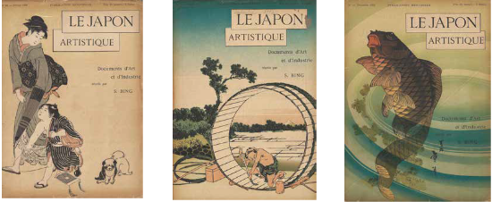
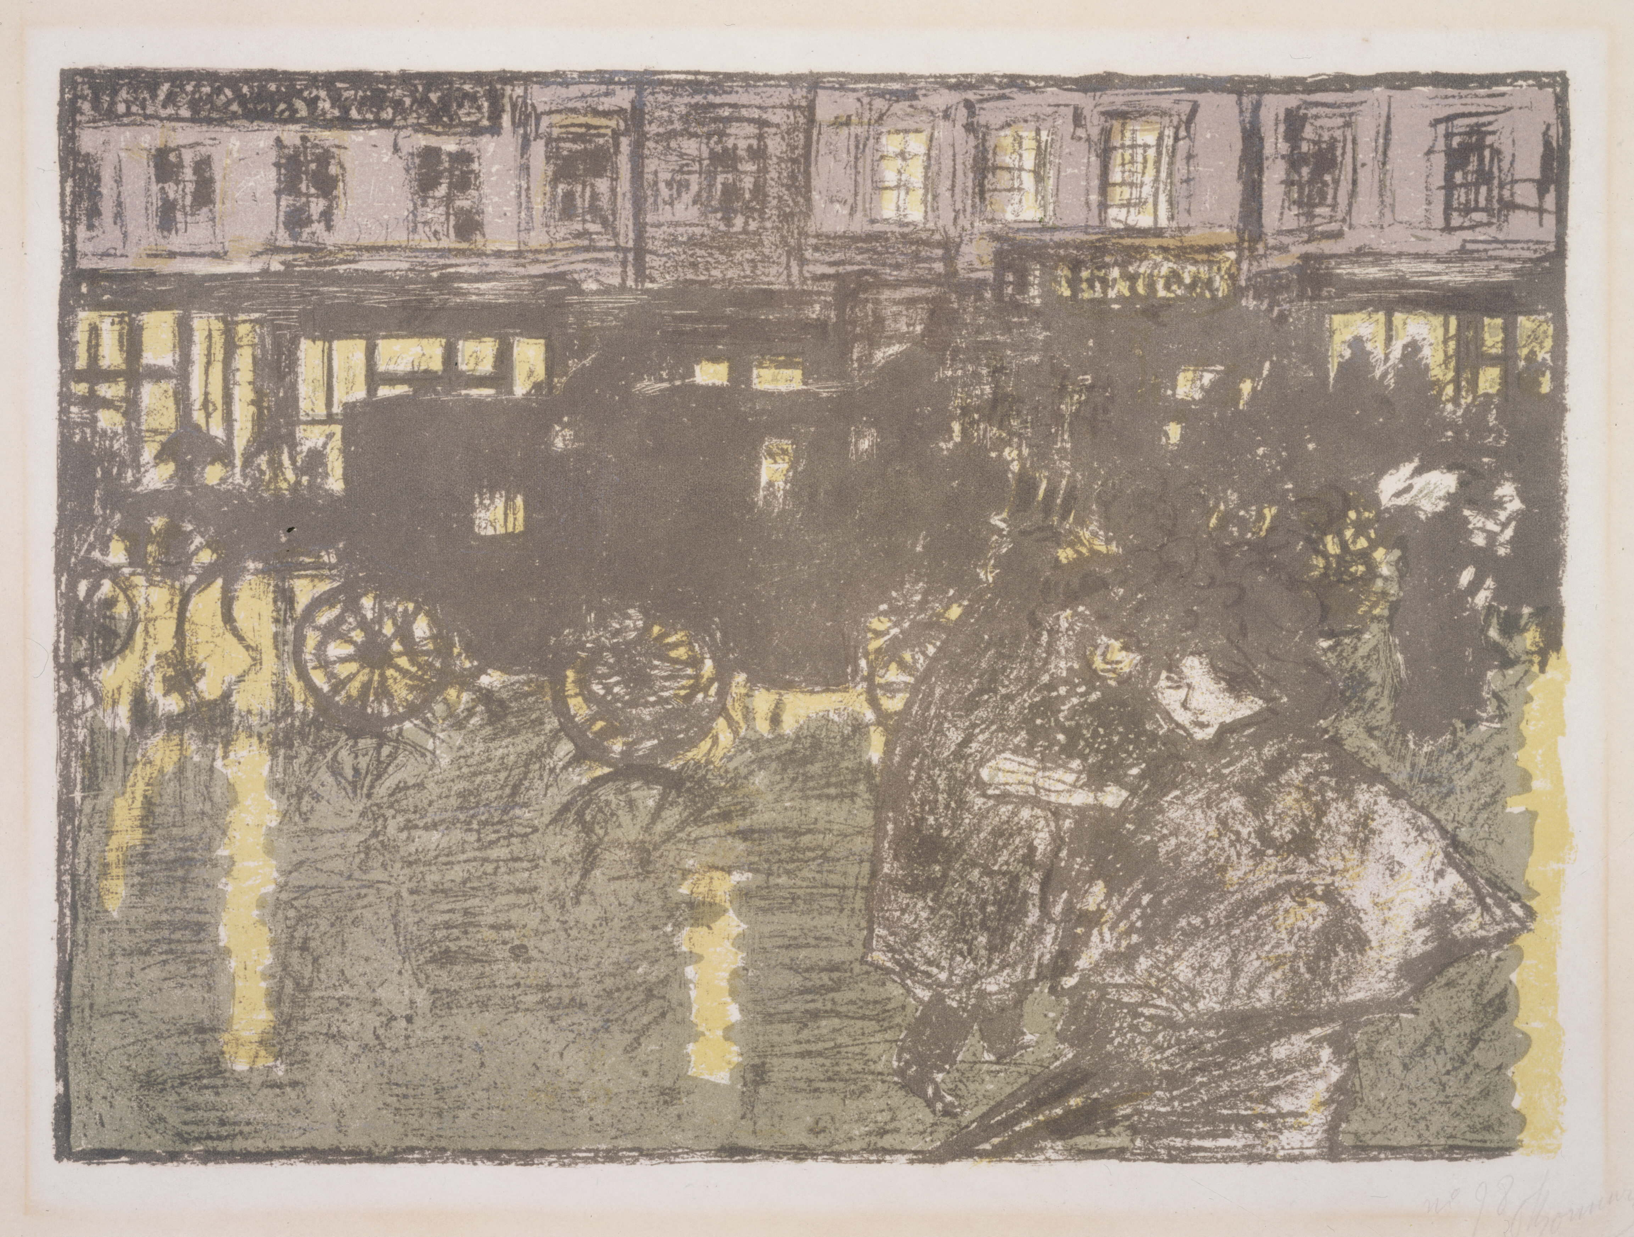
Le Japon Artistique. Documents d’Art et d’Industrie
1888-1891
Parisian life
Baron Haussmann’s vast public works programme during the Second Empire turned Paris into a truly modern capital city. Thanks to its orderly buildings, wide avenues, gardens and gaslights at night, Paris became known as the City of Light. Bonnard quickly fell in love with this city in perpetual motion. He painted passing horse-drawn carriages, streetcars and omnibuses, a mass from which the face or profile of a person on the street, the reflection of street lamps at night and lively cafés sometimes peeked out. Between 1895 and 1898, he created an album of colour lithographs featuring these urban landscapes titled Quelques aspects de la vie de Paris.
The ever-changing city led them to daring compositions, simplified shapes, sharp colour contrasts and a language of allusion and Decorativism, all characteristic of the Nabi style. Other artists in the group, such as Ibels, Vuillard and Vallotton, also interpreted urban life, masterfully representing its frenzied atmosphere.
Pierre Bonnard
Rue le soir sous la pluie, 1897-1898

Slide 10
Theatre, music and shows
The Nabis loved live shows, frequenting the opera, theatre, circus and music halls, where they paid as much attention to the performance as the audience watching the stage.
From the end of the 1880s, the Nabis worked with Paul Fort’s Théâtre d’Art, which put on an experimental Symbolist repertoire. They made suggestive sets for the plays of Maurice Maeterlinck and poetry readings of Paul Verlaine, Arthur Rimbaud and Stéphane Mallarmé. None of these ephemeral constructions remain. From 1893, the Nabis joined Aurélien Lugné-Poe’s Théâtre de l’Œuvre, where Vuillard, Bonnard, Denis, Roussel, Sérusier and Vallotton created sets, costumes, programmes and posters for the dreamlike, spiritual Symbolist repertoire. After Alfred Jarry’s Ubu roi, which premièred in 1896, some of the Nabis took part in musical productions at Théâtre des Pantins, with marionettes, while Bonnard collaborated with his brother-in-law, composer Claude Terrasse, illustrating his scores and solfège teaching books.
Symbolism. Between esotericism, dreams and mysticism
The idealistic renewal and Neo-Spiritualism of the 1890s truly struck a chord with the Nabis. Denis believed spirituality was inseparable from artistic creation: his work is deeply marked by the Catholic faith, the sanctity of music and the idealisation of women. Similar to the Symbolist poets, he also developed a point of view blending fantasy and real places, often drawing from religious mysticism.
Ranson was passionate about esotericism, painting forests full of disturbing characters, such as witches. Sérusier and Lacombe, imitating other Symbolists, transformed the woods of Brittany into a sacred, mystical site. Roussel continued this fascination with the sacred forest, a mysterious, dreamlike place perfect for exploring parallel worlds. These extraordinary subjects drew them deeper into aesthetic innovation, combining visible and invisible elements in their compositions.
Paul-Élie Ranson
Deux femmes nues, 1892

Slide 11
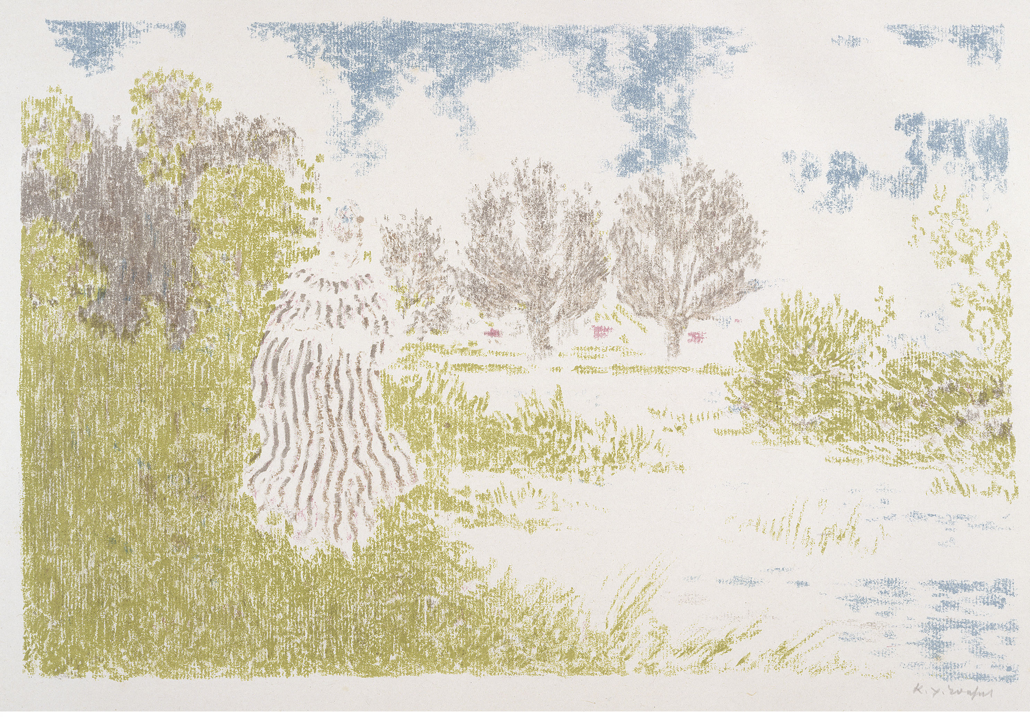
Landscapes and gardens
Despite loving the city, the Nabis didn’t neglect landscapes, urban or rural. Gardens, squares and parks played a key role in their work. These spaces where people meet and interact in the city are a backdrop for everyday life. There Bonnard, Vuillard and Roussel observed children playing, nannies and mothers watching them, and portrayed the bonhomous atmosphere of these Parisian moments. Vuillard created many pocket-sized oil paintings, expressing his fleeting impressions in bright colours on cardboard.
The huge garden at the Bonnard family home in Isère inspired outdoor compositions livened up by his nieces and nephews and the animals in the neighbouring field. For Roussel, who lived on the outskirts of Paris in an area that was still quite rural, people carried a symbolic weight. Nymphs or muses, their poetic presence became decorative, and the human figure blended with nature in a timeless, harmonious scene.
Ker-Xavier Roussel.
Femme en robe à rayures, 1898
Modern decoration
Among the Nabis, the concept of decorativeness played a central role, given their desire to abolish hierarchy in the arts and move beyond the separation of fine art and crafts. From the very beginning, they created decorative elements for private settings, commissioned by patrons. At the same time, they explored the potential of colour lithography, allowing them to mass-produce pieces that were easy to distribute.
Collaborating with founder of The Maison de l’Art Nouveau Sigfried Bing, the Nabis took part in the first Salon de l’Art Nouveau in December 1895, showing decorative panels, fans, wallpaper and decorative porcelain pieces. Ranson and Maillol also created the designs for tapestries woven by their wives. Vallotton, Bonnard and Maillol produced statues of women to decorate the homes of the bourgeoisie. The Nabis’ interest in the applied arts was part of the great aesthetic renewal in Europe that was Art Nouveau.

Slide 12
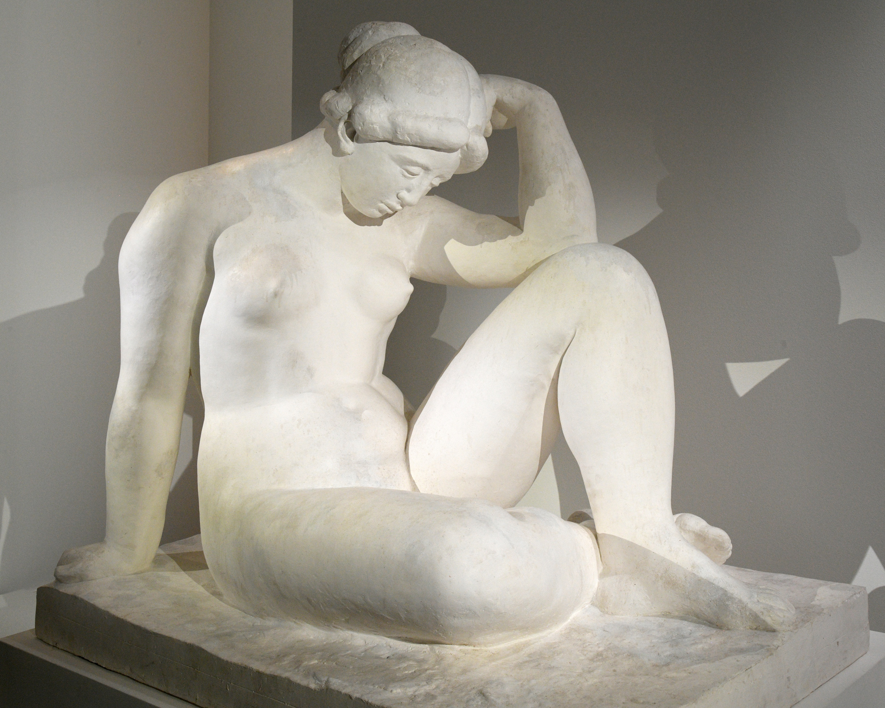
Representations of daily life
In the Nabis’ paintings, the domestic realm is portrayed as essentially a place for activities traditionally associated with women: housework, childcare or sewing. Sewing has a noteworthy place in Vuillard’s work, as his mother ran a corsetry workshop in their flat. Inspired by the movements of the corset-makers and their customers, this intimate world was full of work, posing, gossip and tensions, which the artist insinuated with a subtle play of light and shadows and of colour contrasts.
Denis, who had many children, devoted much of his work to motherhood, which he portrayed both from a quotidian angle and with an idealised, almost sacred, view of the maternal bond. Less often, women appear in intellectual pursuits, such as Vallotton’s portrait of Misia at her dressing table. Like Bonnard, he focused on sensual intimacy, with many compositions of nudes exuding refined eroticism.
The Mediterranean
In 1890, Maillol met Hungarian Nabi Rippl-Rónai, who he introduced to the rest of the group and in Parisian Symbolist circles. Painter, printmaker, tapestry weaver and not long after potter and sculptor, the young man from Northern Catalonia worked in a variety of techniques, but always highlighted the female nude, which he considered a source of infinite shapes. Lacking models, in the beginning he drew inspiration from the figures in Gauguin’s work, but he later created his own language of stylised nudes with sturdy, voluptuous physiques.
Aristide Maillol
Méditerranée, 1905
Around the turn of the 20th century, after working on wood engravings, a tapestry and a plaster relief sculpture titled La vague, Maillol made a small nude of a woman sitting with bent knees that Count Kessler fell in love with on the spot. The artist’s patron commissioned him to make a stone version, which ended up becoming the sculpture Méditerranée. The monumental plaster piece for the Count was exhibited at the Salon d’Automne in 1905. At the time, Maillol told a childhood friend: “My intention [...] was to create a young, pure, luminous, noble figure. Isn’t that the spirit of the Mediterranean? Well, that’s why I gave it the name.”

Slide 13
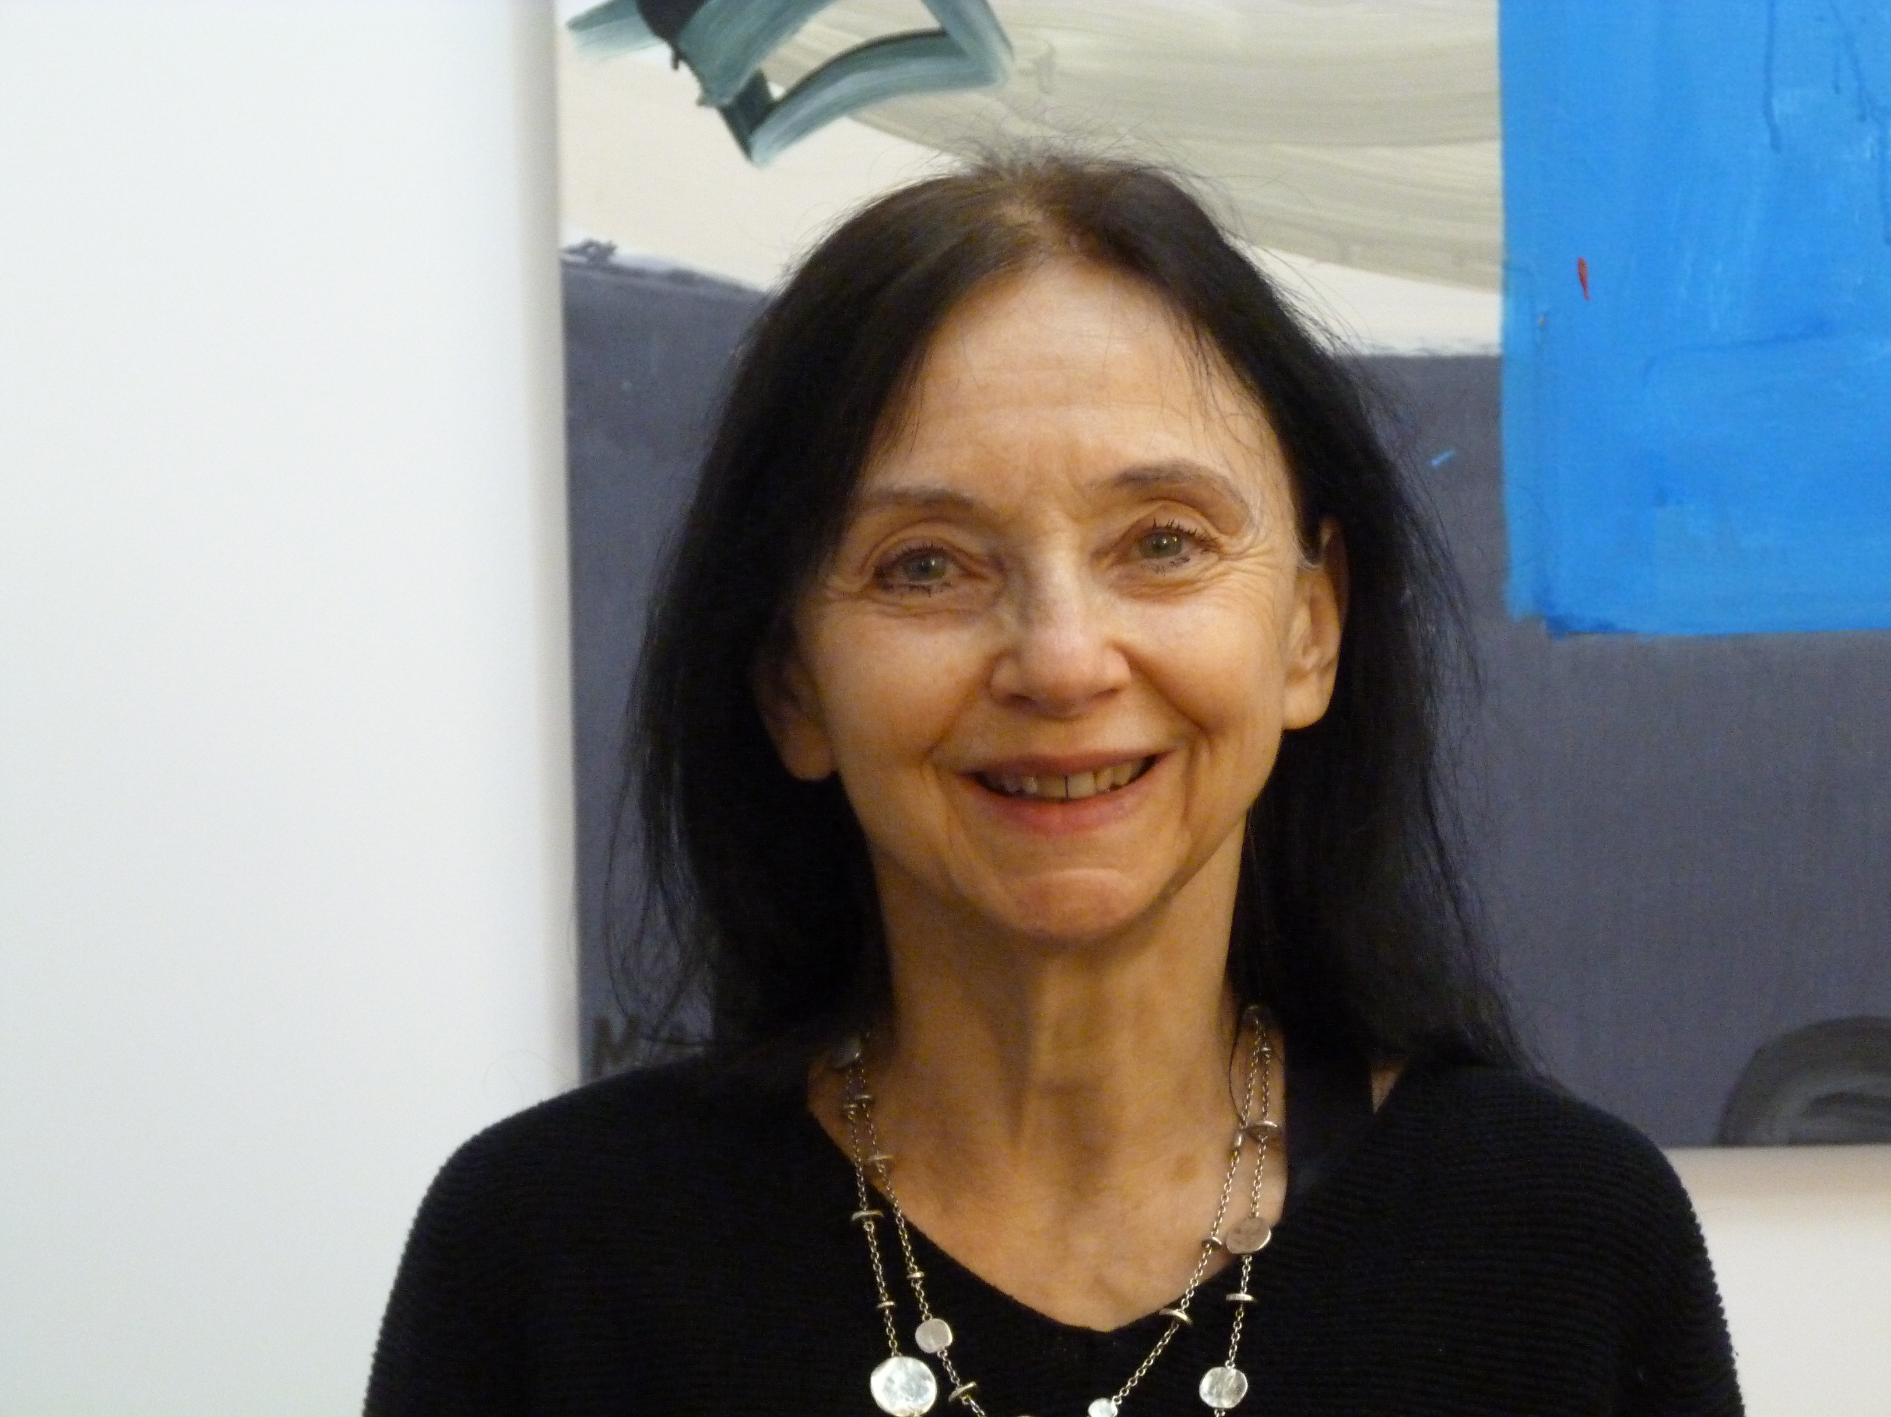
Isabelle Cahn, curator
Art historian and honorary general curator of paintings at the Musée d’Orsay, Isabelle Cahn specialises in art from the second half of the 19th century and early 20th century. Curator of numerous exhibitions in France and the world, she is a renowned expert in Post-Impressionism and, more specifically, the Nabi movement.
Among others, she has curated important exhibitions on Félix Vallotton (Grand Palais, Van Gogh Museum Amsterdam, Mitsubishi Ichigokan Museum Tokyo), Pierre Bonnard (Musée d’Orsay, Fundación MAPFRE Madrid, Fine Arts Museums of San Francisco, National Art Centre Tokyo, Musée de Grenoble, Hôtel de Caumont), as well as “Les Nabis et le décor” at Musée du Luxembourg and “Affinités japonaises, vers le décor moderne” at the Louvre Abu Dhabi. She was also the curator for “Maurice Denis. Amour” at Musée cantonal des Beaux-Arts in Lausanne and “David Hockney. Le chant de la terre” in Mons.
Specialising in Gauguin, Cézanne and Van Gogh, she organised the Musée d’Orsay exhibition “Van Gogh/Artaud. Le suicidé de la société”, which saw more than 750,000 visitors in 2014.
Committed to an open, polysemous approach to art, she has put together several exhibitions on noteworthy artists and intellectuals, including Lugné-Poe at Musée d’Orsay, Misia Godebska at Musée d’Orsay, Félix Fénéon (at Musée de l’Orangerie, Musée du Quai Branly and MoMA New York), as well as Marcel Proust and Alfred Dreyfus at Musée d’art et d’histoire du Judaïsme in Paris.
Scientific director of numerous catalogues, she has also written books, essays and articles on the art of the end of the 19th century and the beginning of the 20th century.

Slide 14
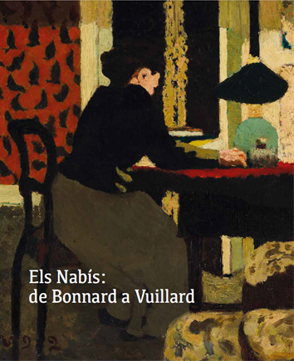
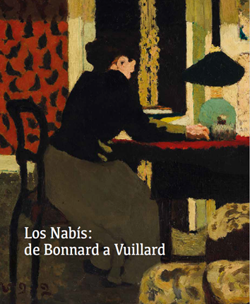
Catalogue
To accompany the exhibition, there is a catalogue featuring all of the works on display with several essays by Isabelle Cahn (exhibition curator), Mathias Chivot, Elise Dubreuil, Léila Jarbouai, Jean-David Jumeau-Lafond, Magali Lesauvage, Bertrand Lorquin, Marc Olivier Ranson Bitker, Cristina Rodríguez-Samaniego, Teresa-M. Sala and Véronique Serrano. It also includes biographies of the artists by Flora Vinatier and a brief timeline.
The catalogue is available in Catalan and Spanish editions, both with English translations.
It has a total of 280 pages.

Slide 15
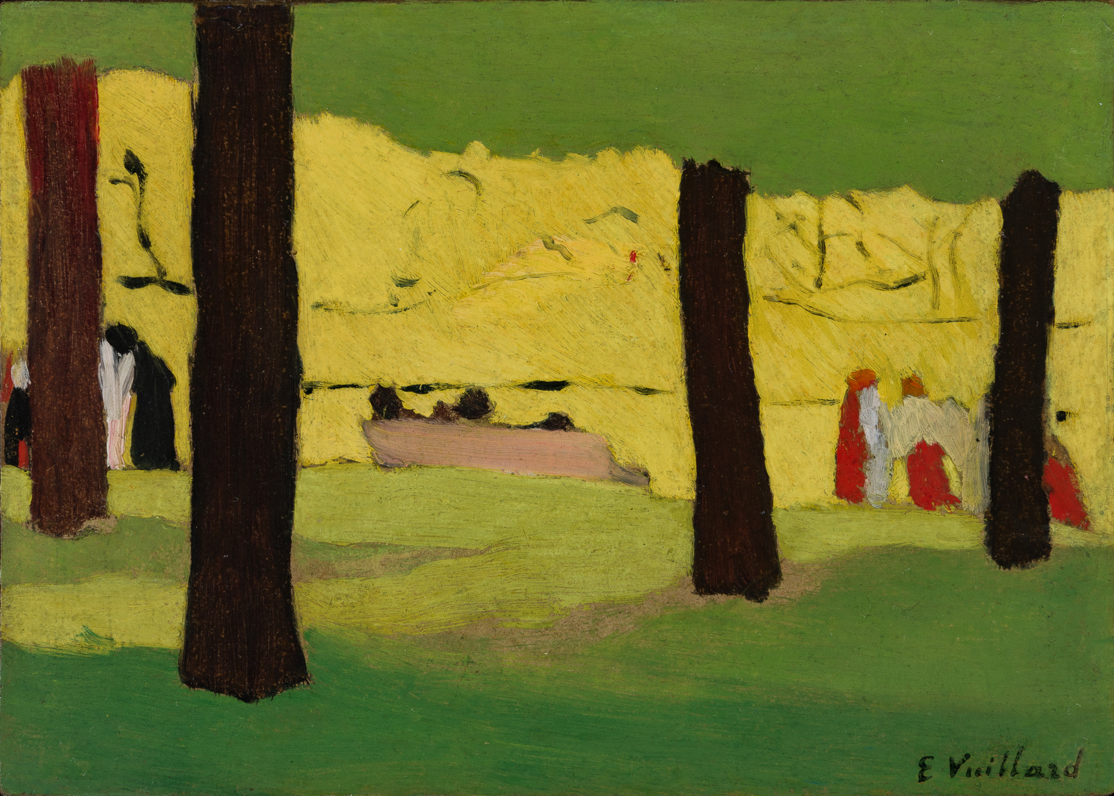
Activities
The Fundació Catalunya La Pedrera is committed to promoting art and culture through programming of exhibition experiences, which is part of our DNA and our founding purpose.
The Foundation acts on this commitment to promoting art and culture through programming based on strategic partnerships and cultural connections. The Foundation is dedicated to helping transform Barcelona’s cultural landscape, hosting public exhibitions and activities that enrich cultural life in the city.
These alliances with the best possible partners are a core pillar of our strategy and are precisely what makes us unique. The exhibitions aren’t confined to the building, they radiate outwards into the city, forging connections with activities at institutions such as the Gran Teatre del Liceu and Palau de la Música Catalana, among others, that take the exhibition beyond the walls of La Pedrera, offer new perspectives and encourage dialogue with other art disciplines.
This strategy of collaborating with other cultural bodies further strengthens our commitment to an enriching cultural experience and demonstrates our shared commitment to expanding the project beyond La Pedrera. Because this teamwork makes the exhibitions more accessible, opening them up to a broader audience.
Édouard Vuillard. Le banc rose, 1890

Slide 16
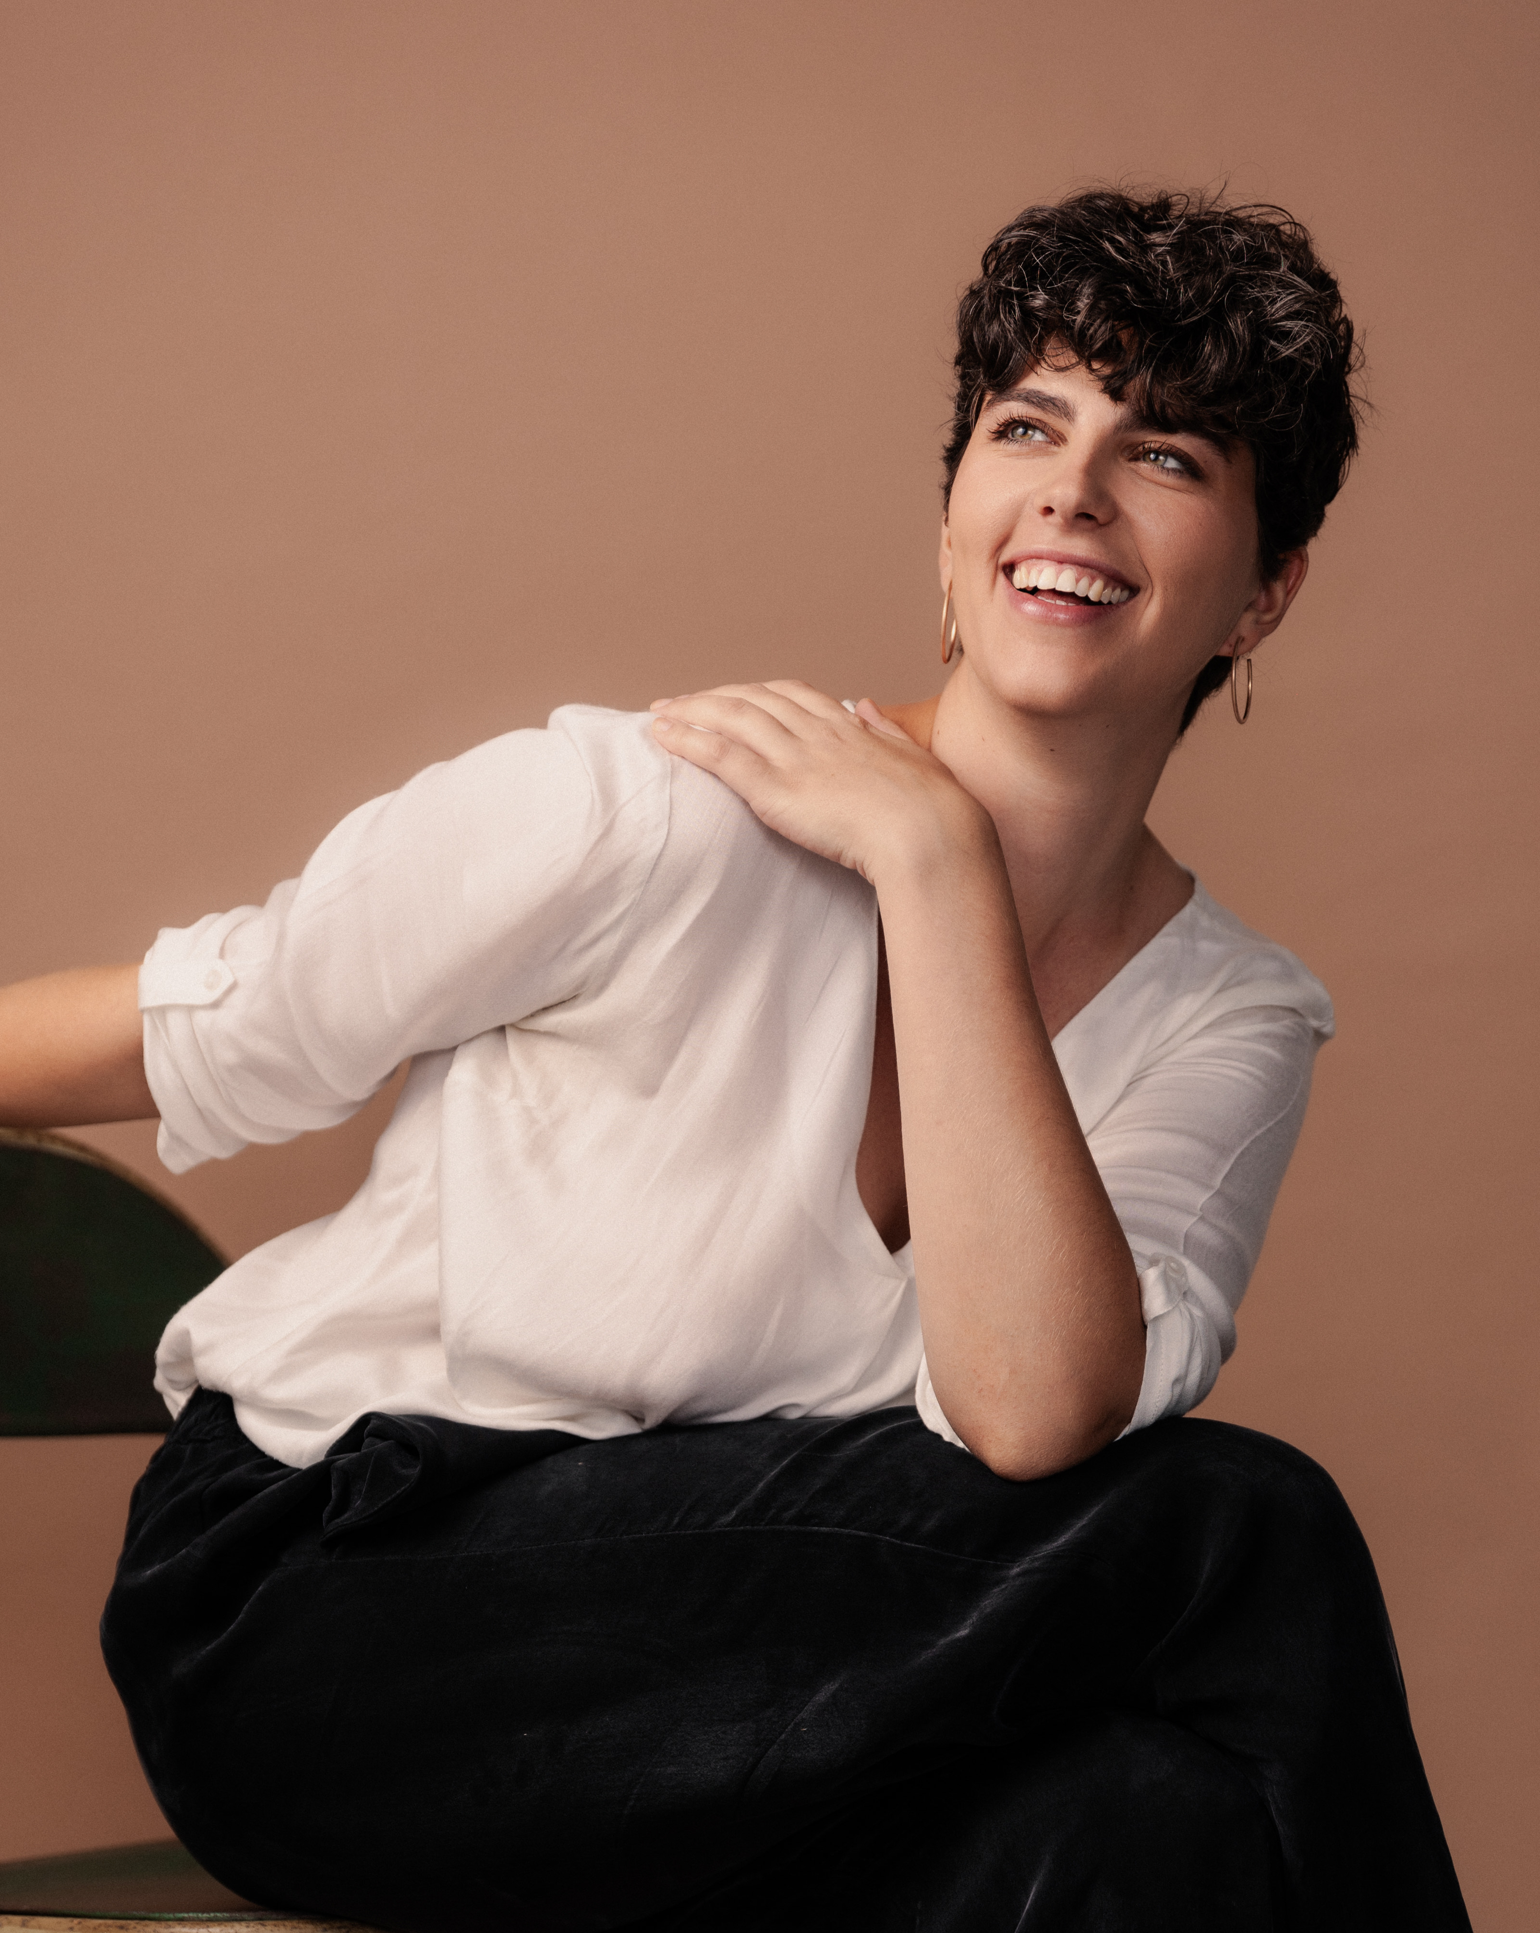
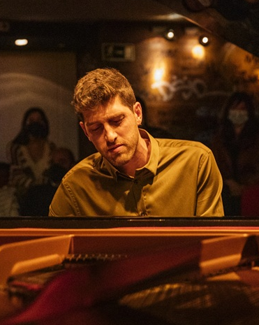
Activities related to the exhibition
Guided tour of Picasso Museum Barcelona
For the Picasso Museum Barcelona exhibition “Ubu painter. Alfred Jarry and the arts”, we propose a guided tour connecting this display to the exhibition at La Pedrera on the Nabi artists.
It will explore the ties between the Nabis and Alfred Jarry and examine the works and ideas of this French group that was active between 1888 and 1900. Through a selection of pieces by Pierre Bonnard, Édouard Vuillard, Maurice Denis, Félix Vallotton and other creators, participants will discover this movement that marked the transition from Impressionism to the early avant-garde movements of the 20th century and promoted a new understanding of painting and art in everyday modern life.
A unique guided tour to understand the connections between two artistic worlds that transformed the visual culture of their time.
Artistic convergence: the Nabis and Alfred Jarry
Tuesday 17 March at 6:00 pm
Musical evocations: from Paris to Barcelona Palau de la Música Catalana
Mireia Tarragó and Marc Serra will perform a concert exploring the relationship between the Nabi movement and Modernisme, and the cultural and musical movement of the time in Catalonia.
Through a varied programme, the concert will draw aesthetic parallels between Catalan Modernisme and the pictorial avant-garde of the Nabis and the music of their time —Gabriel Fauré, Claude Debussy, Erik Satie, Mel Bonis. The pieces reflect the Symbolist spirit and poetical nature of both movements. The concert also highlights the rich cultural scene in Catalonia around the turn of the 20th century, which included Isaac Albéniz, Enric Granados, Lluïsa Casagemas and Pau Casals.
Concert by Mireia Tarragó and Marc Serra at Palau de la Música
Friday 10 April at 7:30 pm

Slide 17
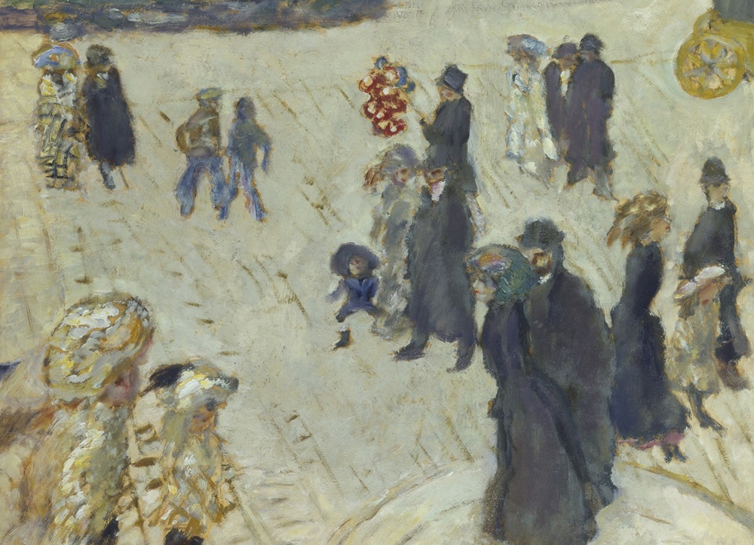
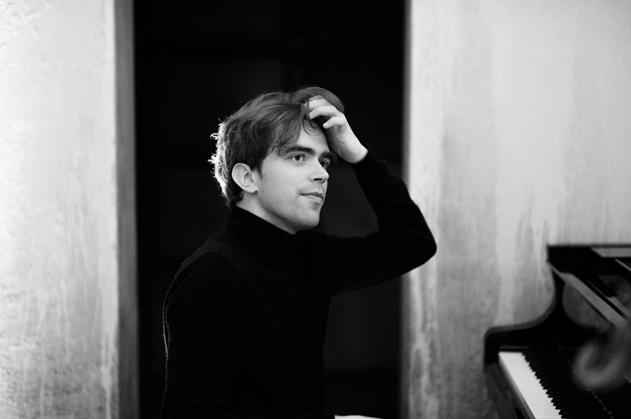
Tours and talks
A morning devoted to the La Pedrera exhibition, designed as an invitation to explore the Nabi movement from different perspectives and through various art disciplines.
The session will feature director Lluís Danés, author Carlota Gurt and art historian Teresa M. Sala, allowing participants to rediscover the exhibition through a new lens and enriching understanding with diverse perspectives. There will also be a guided tour for all audiences, a family activity designed for the little ones and their families, and short musical interludes by students from Escola Superior de Música de Catalunya (ESMUC). A day to delve deeper into the world of the Nabis through a dialogue among the arts.
“The Nabis: from Bonnard to Vuillard”
Sunday 19 April from 10:00 am to 2:00 pm
Concert and visual show. Gran Teatre del Liceu
The Nabis had a deep, lasting connection to music. Fervent admirers of Ludwig van Beethoven and fascinated by the world of Wagner, they forged close bonds of friendship and collaboration with composers of the time. The influence of music can clearly be seen in some of the group members’ work on sets for Théâtre des Champs-Élysées (1911), where their desire to create complete artworks culminated in a piece integrating architecture, painting and music all in one space.
Albert Cano Smit proposes an intimate recital featuring a journey through different types of melancholy, with works by Erik Satie, Claude Debussy, Saint-Saëns, Mel Bonis, Gabriel Fauré, Cécile Chaminade, Maurice Ravel, Modest Mussorgsky and César Franck, in line with the poetic and spiritual sensibilities of the Nabi movement.
Piano recital by Albert Cano Smit in the Foyer at the Liceu
Tuesday 12 May at 8:00 pm

Slide 18
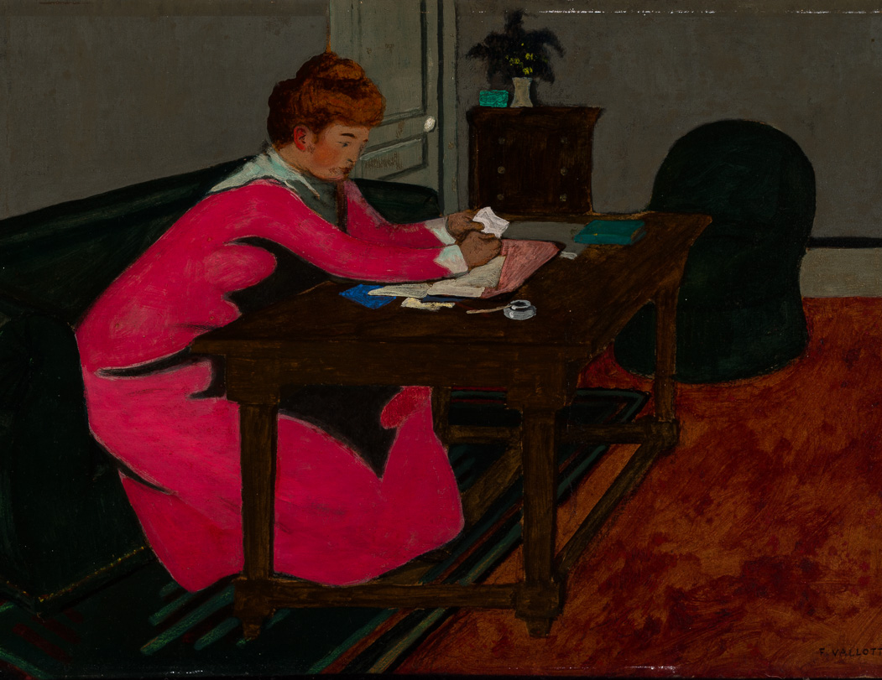
2026 Barcelona Poesía festival
As part of the Barcelona Poesía festival, you are invited to an event featuring poetry and music, exploring the deep connection between painting, music and writing.
The Nabis, active between 1888 and 1900, shared a desire with the French Symbolists, such as Stéphane Mallarmé, Paul Verlaine and André Gide, to transcend reality and make art a spiritual, sensory experience. Inspired by this ambience, we propose a journey in which the works of Pierre Bonnard, Édouard Vuillard, Maurice Denis and Félix Vallotton enter into a dialogue with verses and melodies evoking the mystery, suggestiveness and hidden beauty that characterise Symbolism.
French poetry reading
Tuesday 19 May at 7:30 pm
Guided tour of MNAC
Organised in collaboration with the Museu Nacional d’Art de Catalunya (MNAC), this activity is a unique opportunity to get a closer look at the Nabis and their echoes in Catalan art from the beginning of the 20th century through connections between the exhibition and the MNAC permanent collection, particularly works related to Symbolism and Catalan Modernisme. Through a conversation among specialists from the two institutions, the visit journeys through various spaces and sensibilities, inviting participants to discover new readings of a key period in modern art.
Shared vision: the Nabis and similarities with Catalan art
Saturday 6 June at 11:00 am

Slide 19
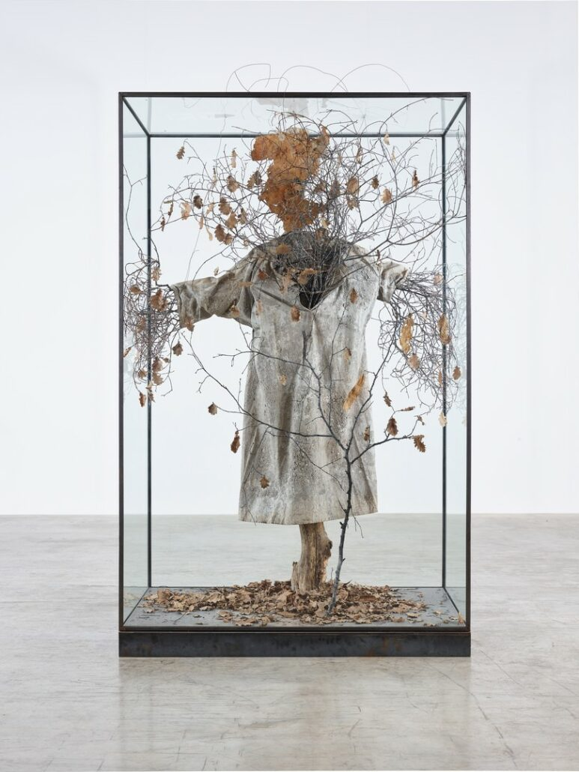
The Nabis: from Bonnard to Vuillard
Important information
6 March to 28 June 2026
Monday to Sunday, from 10:00 am to 7:30 pm (last entry: 7:00 pm).
General admission: €14
#NabisLaPedrera
Next exhibition
“Anselm Kiefer”
From 2 October 2026 to 24 January 2027
Anselm Kiefer
Daphné, 2016

Slide 20
Fundació Catalunya La Pedrera
The Fundació Catalunya La Pedrera is committed to promoting art and culture through carefully considered programming of exhibition experiences, thus reaffirming one of its founding purposes: to act as a cultural catalyst for society.
Lluïsa Oller Martín Communication, Fundació Catalunya La Pedrera +34 638 44 94 69 premsa@fcatalunyalapedrera.com

